Slide 1
Android Trends
Shafiul Hasan

Slide 2
Why mobile platforms ?
Mobile is the latest trends.
Desktop is dying .
Web is boring.
Mobile is the buddy.
Mobile is the future.
Mobile development is challenging.
Mobile/tablets will swipe the old heavy desktop/laptops.
Mobile is fun .

Slide 3

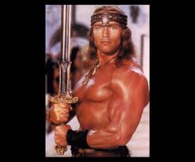
Different mobile platfroms.
IOS
Android

Slide 4


Windows
Black Berry

Slide 5

Native vs WebApps
Native
Web Apps
Strong.
Performance.
Uniform UI.
Security.
Power efficient.
More native.
It is like Witch (some times beautiful, ugly when you discover them)

Slide 6

Why android …?
Please tell me why you all wants to be android developer ?

Slide 7

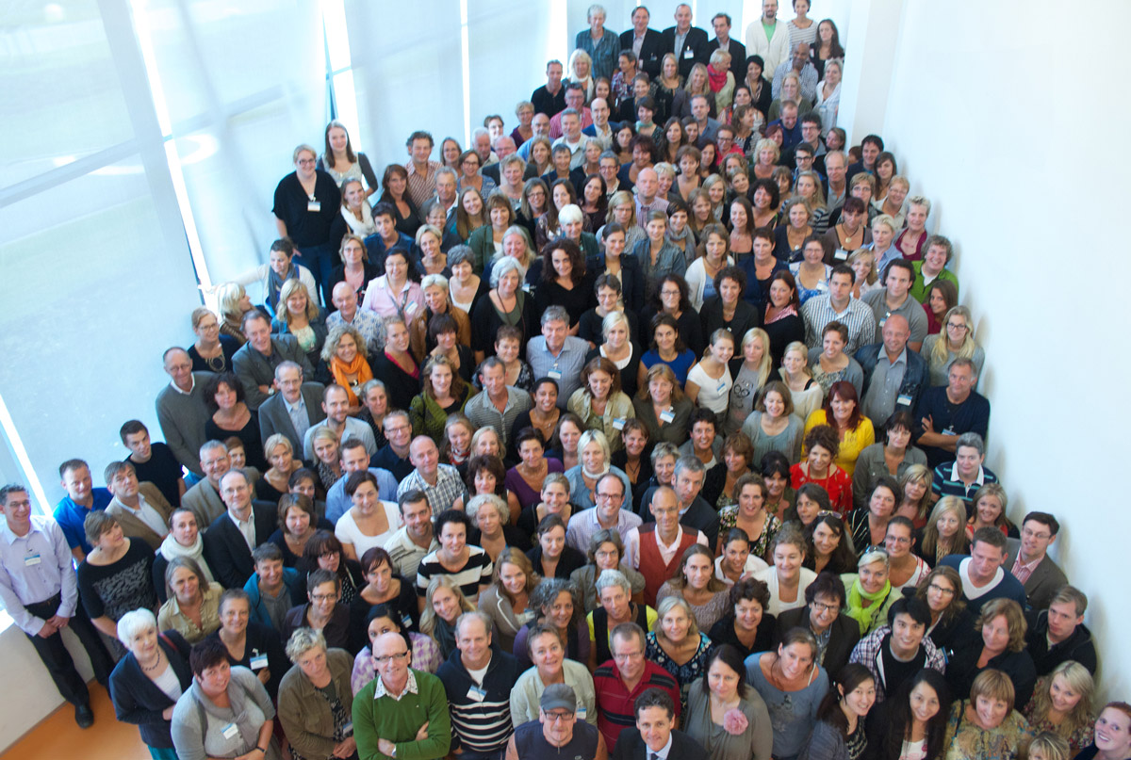
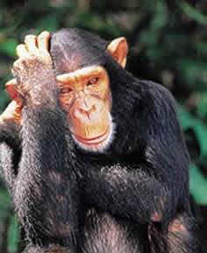
Some problems asusual
** One thing I must warn you, android development is pain in the ass some times
** If you wants to freelance then it has more competitions then other projects.
** Google play is still unavailable in Bangladesh.
for creating accounts :(.

Slide 8
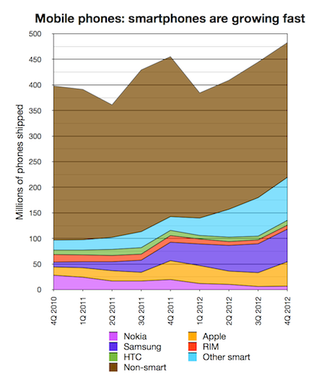
Smart phones numbers

Slide 9
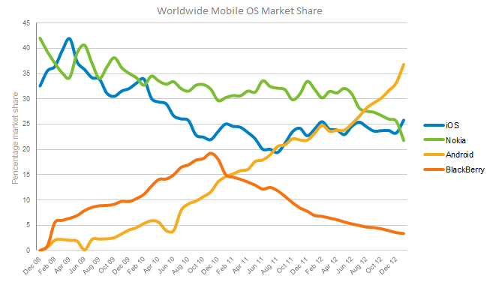
Mobile market share

Slide 10
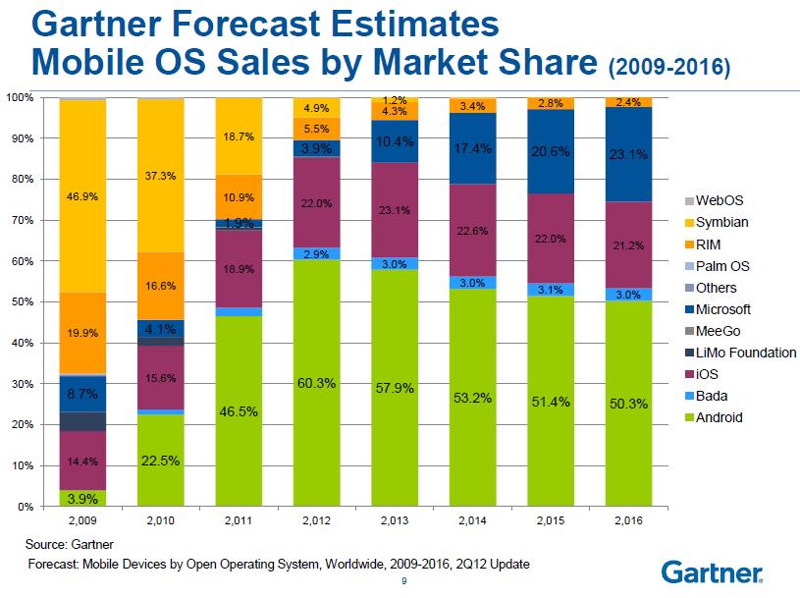
Some Inspiring Statics.

Slide 11
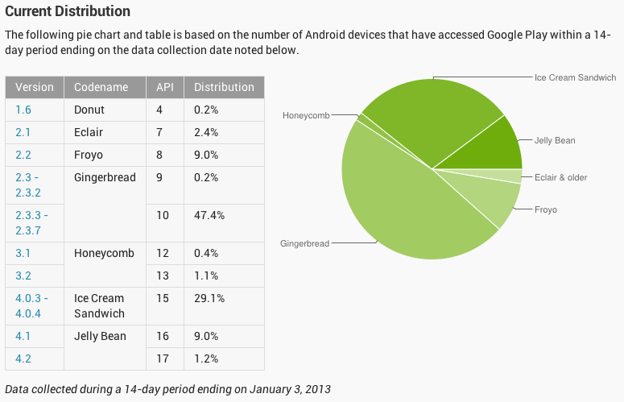
Android’s version map

Slide 12
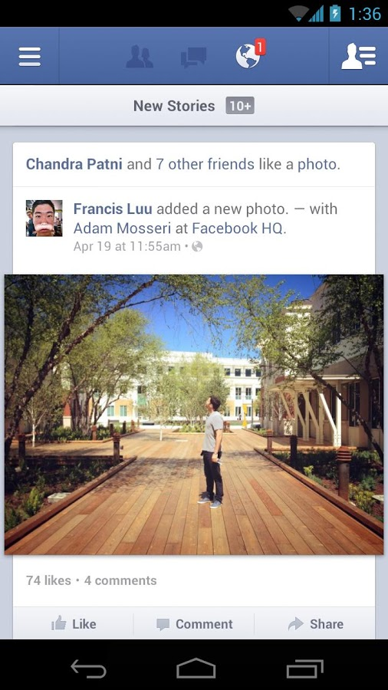
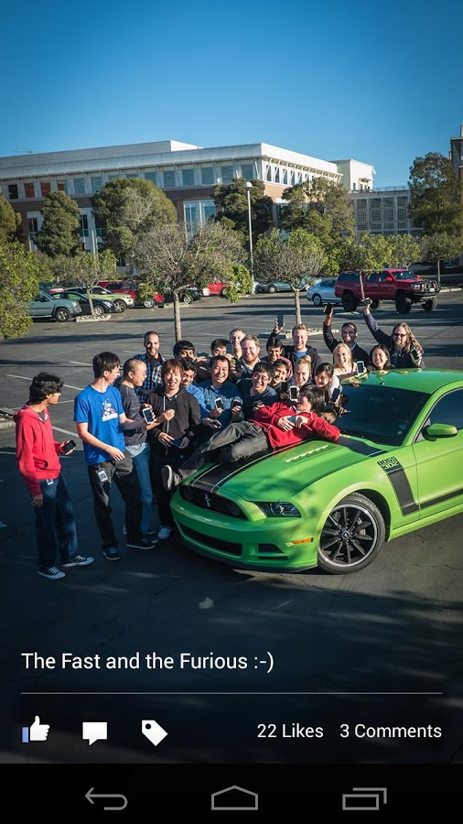
Some mostly downloaded apps
Facebook

Slide 13
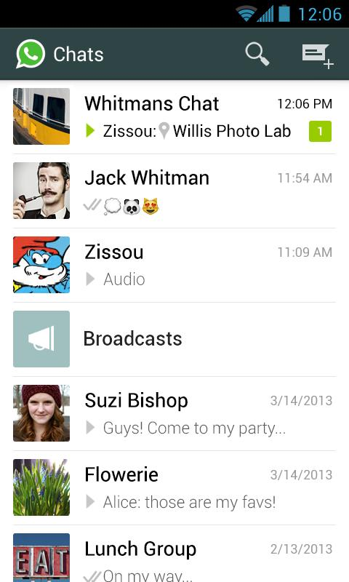
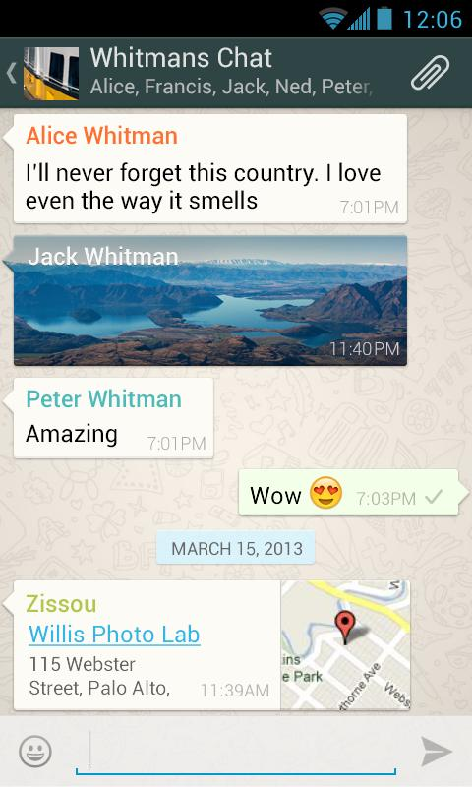
Whats App Messenger.

Slide 14
When will we build something like these apps ?
If ( countHortalsInLastTwoYears()== 0 ){
// Impossible condition , so it will be never executed.
throw new Exception(“Impossible condition executed. ”);
}

Slide 15
Any questions ?
Please do not ask any question now, I need a 5 minutes break now ☺.

